Slide 1

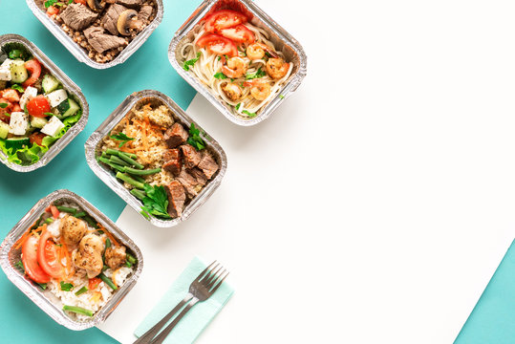
Food Delivery Project

Slide 2

Team Members
DEVVRAT KAUSHIK
ISHITA GOYAL
NUPUR KAWTRA
SANSKRUTEE DUDHE

Slide 3

Introduction
Grubhub Inc is an American online and mobile prepared food ordering and delivery platform based in Chicago Illinois. Founded in 2004, it is a subsidiary of the Dutch company Just Eat Takeaway since 2021. Grubhub has been criticized for antitrust price manipulation, listing restaurants without permission, and allegedly misclassifying workers. Grubhub Seamless went public in April 2014 and was traded on the New York Stock Exchange under the ticker symbol GRUB as of 2019, it had 19.9 million active users, with 115,000 associated restaurants in 3,200 cities in all 50 US states

Slide 4

Objective
Developing a recommendation model based on scraped data from Grubhub and make a webpage of it.
Design algorithms, analyzing user data to generate personalized recommendations based on past ratings, cuisine preferences, delivery review number and location.
Enabling users to access information about cuisine availability at different restaurants and preferred price ranges.
Develop user-friendly interface for feedback, enabling users to explore menus, reviews, and ratings of recommended restaurants.
Assisting potential restaurant owners in determining optimal cuisine offerings and average pricing for new restaurant ventures.

Slide 5
Data stored as CSV
After extraction and processing, we saved the cleaned and structured data as CSV files for further analysis
Data Extraction We used Python. Beautiful Soup: and Selenium to scrape data
Data Cleaning
Cleaned, validated, and formatted the data, handling missing values
PROJECT
Insights Generation Through data analysis and visualization by Power BI, we generated actionable insights.
Visualization
Power BI was used to visualize patterns, and key insights derived from the restaurant data

Slide 6
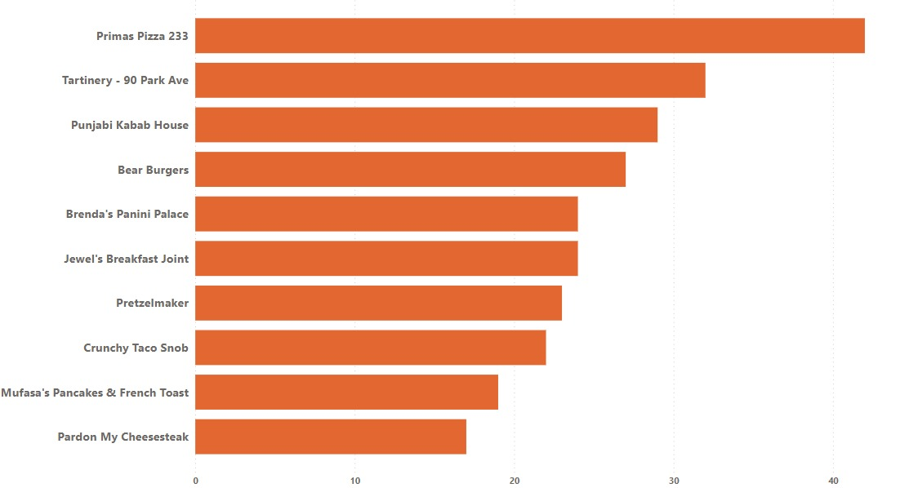
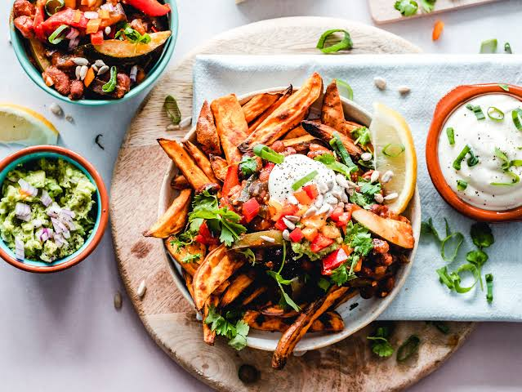
Area-wise Distribution of Restaurant

Slide 7
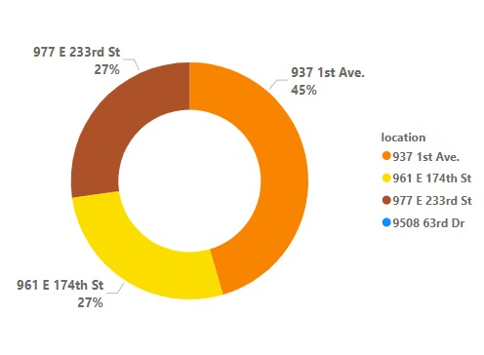
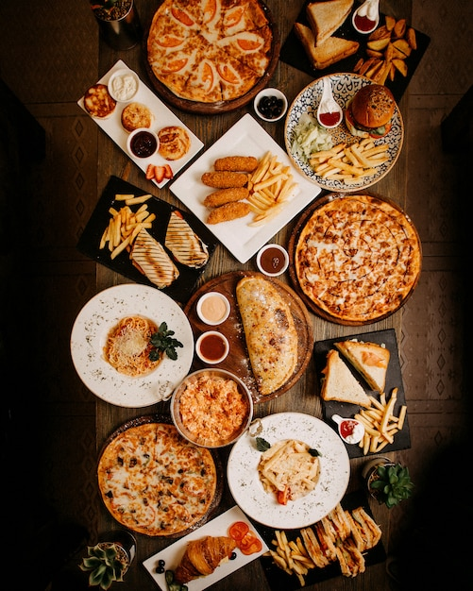
Top 3 location Having most DRN of the Restaurants

Slide 8
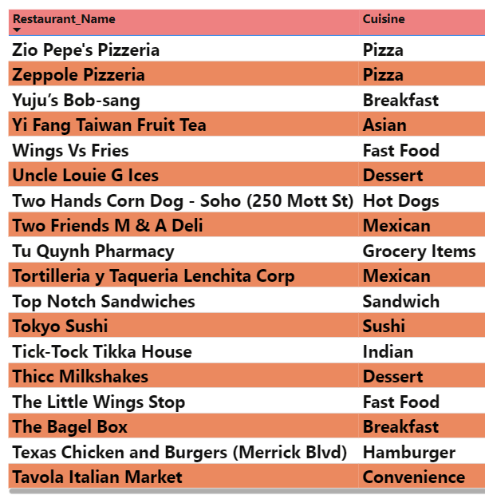

Most Cheapest Restaurants Based On Cuisines

Slide 9
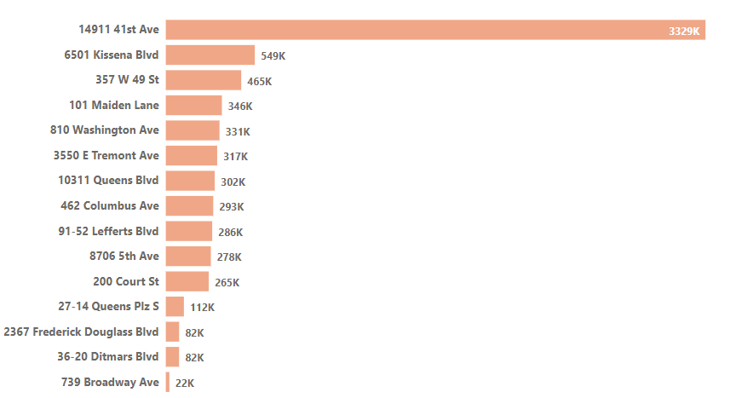
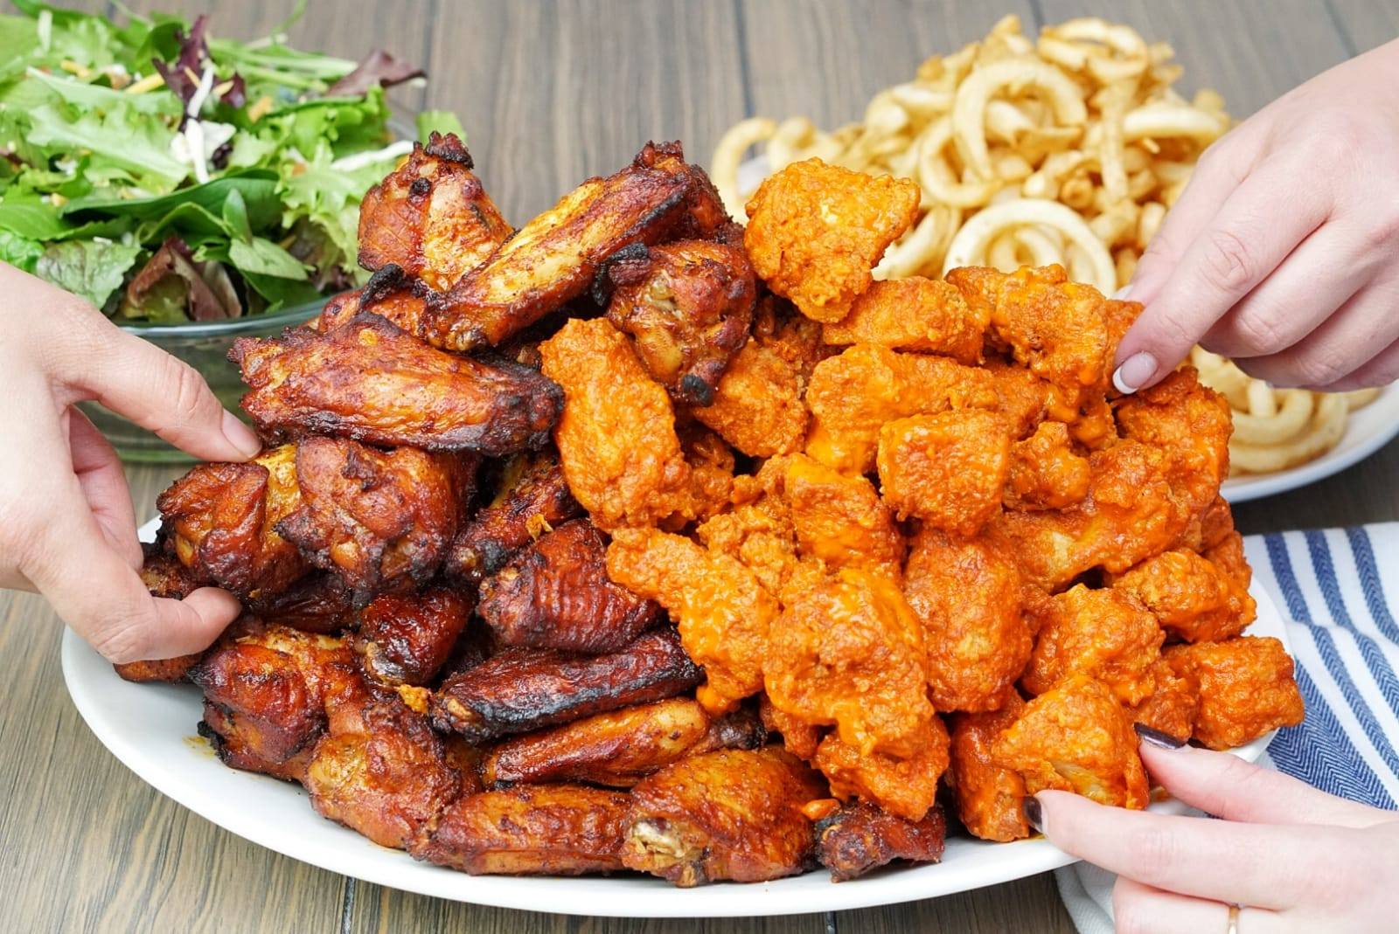
Maximum Restaurants By Each Location

Slide 10
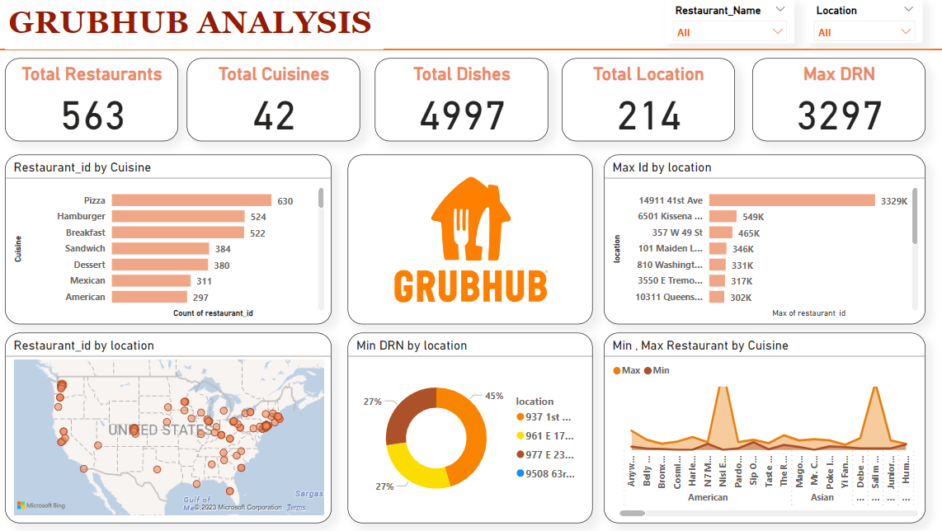


Slide 11
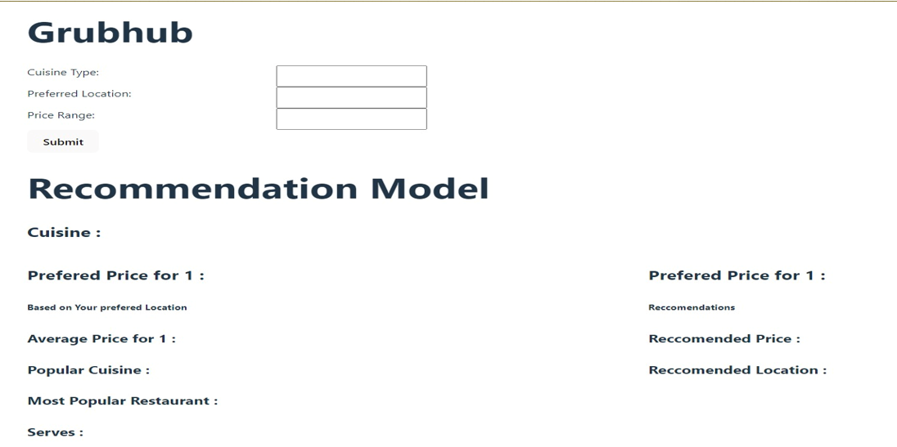
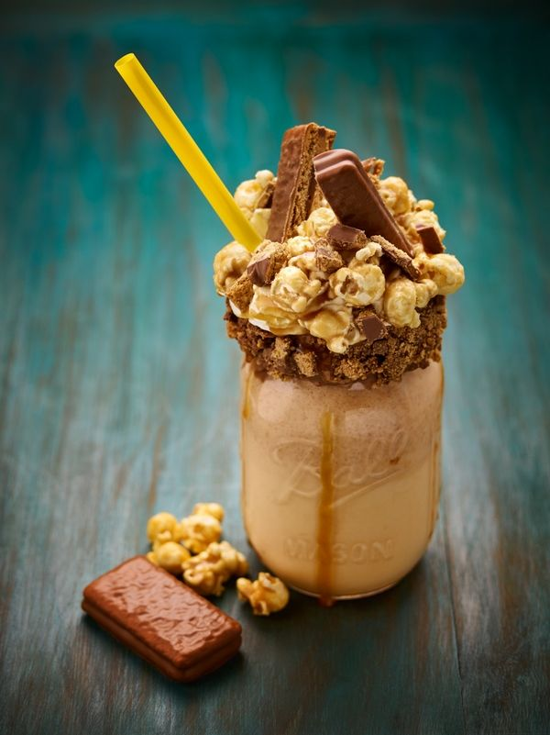
GRUBHUB RECOMMENDATION MODEL
LINK = https://cuisinechase.vercel.app/

Slide 12
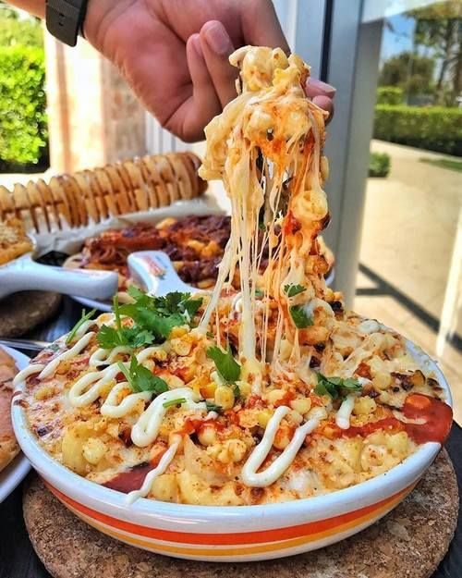
OBSTACLES
EXTRACTING DATA FROM WEB SOURCES WAS A FORMIDABLE ENDEAVOR THAT PRESENTS SIGNIFICANT CHALLENGES..
REPETITIVE WEB SOURCE BLOCKING INCIDENTS HAVE ARISEN DUE TO THE OMISSION OF PROPER DELAY FUNCTIONS IN OUR CODE..
WEBSITES FREQUENTLY UPDATE THEIR STRUCTURE AND LAYOUT WHICH BREAKS OUR SCRAPING SCRIPTS

Slide 13
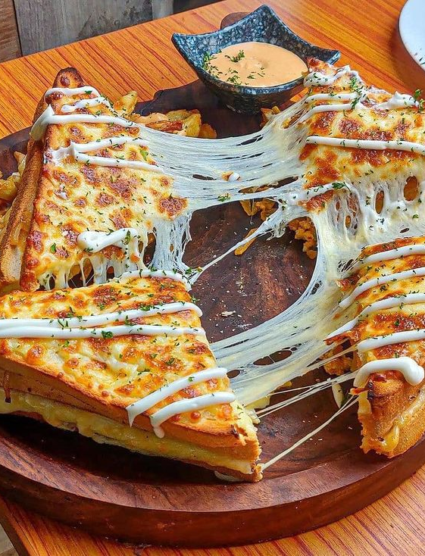
WHAT WE LEARNED
WEB SCRAPPING
PYTHON LIBRARIES LIKE SELENIUM AND BEAUTIFUL SOUP
BASIC KNOWLEDGE OF HTML
TEAM WORK AND COORDINATION.

Slide 14



